Slide 1
Snort & Stuff
J to the R.O.C

Slide 2
Snort: Intrusion Detection (Quck n’ Dirty)
Single threaded intrusion detection system.
Community rules & paid rules
Ability to create your own rules (easy)
Not protocol aware (Bro is)
Must be tuned (like any other IDS)

Slide 3
Snort.conf
Home_NET
DNS_SERVERS
FTP_SERVERS
SSH_SERVERS
TELNET_SERVERS
ECT_SERVERS

Slide 4
Snort Preprocessor
TL;DR: Each protocol has a way it defines how it gets parsed.
You could add new rules to check for non-standard HTTP methods.
TL;DR: You can make things up and it will check for them :D

Slide 5
Snort Anomaly Detection
TCP protocol anomalies, such as data on SYN packets, data received outside the TCP window, etc are configured via the detect_anomalies option to the TCP configuration. Some of these anomalies are detected on a per-target basis. For example, a few operating systems allow data in TCP SYN packets, while others do not.

Slide 6
General Rule Syntax
alert (tcp/udp) network port ← → network port:port
Message: What will appear on Snort alerts
Reference: CVE/Bugtraq/Macafee/ (a few others)
Generator ID (GID): Specifies which part of snort generates an event.
Preprocessors/decoders etc..
Signature ID (SID): Signature ID for rule.
Rev: Revision ID per rule.
Classtype: “Attack class”
Successful-admin, attempted-recon, shellcode-detect, misc-attack
Priority Tag: “How severe is the issue?”

Slide 7
Neat-o things
Regex for rules
Start pcap after rule $X
Probably other things I’ve never done that you know about. This would be a good time to chime in :D

Slide 8
Snort’s can’t handle my spaceship bandwidth, this all sucks! - Ed

Slide 9

Why does it just have to be a tool for defense?

Slide 10

Passive Recon

Slide 11
The quieter you are, the more you can hear!
How could you map out a network by just listening?

Slide 12

Who said what?!
HTTP: user-agent (what browser, maybe OS version)
Where my file shares at?
WPAD?
NBNS?
DNS requests?
Address ranges?
Simple Device Discovery Protocol

Slide 13
You moron tools do this! - Everyone in the audience
Notes:
Network miner, P0f, etc...

Slide 14
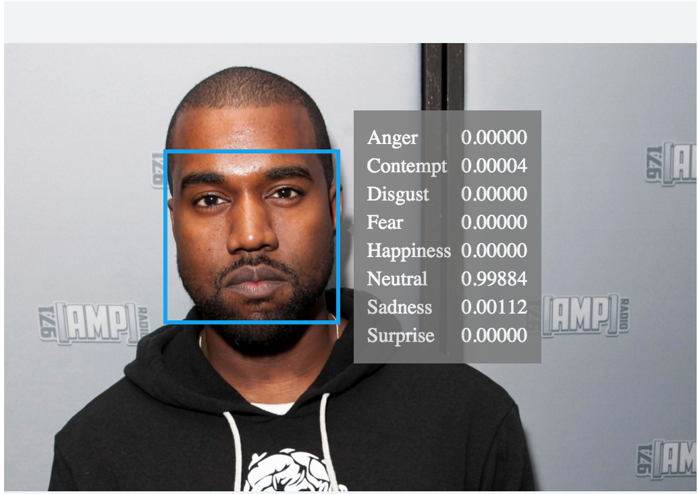
P0f
p0f: Passive OS fingerprinter
https://github.com/p0f/p0f
From the devs: A vast majority of metrics used by p0f were invented specifically for this tool, and include data extracted from IPv4 and IPv6 headers, TCP headers, the dynamics of the TCP handshake, and the contents of application-level payloads.

Slide 15
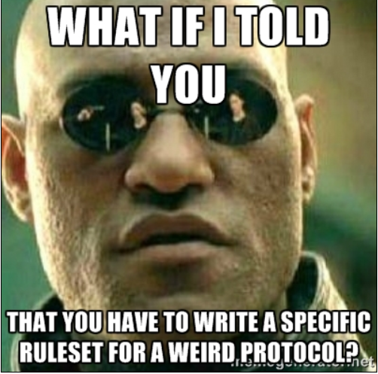
Why not p0f

Slide 16
Whatever Jared no one needs to do this anyway...

Slide 17



Slide 18
GFW: Observe and probe
Unique cipher suite of Tor leads to passive fingerprinting, and then onto active probing.
Obfuscation techniques have been added.
More overhead
Still a cat-and-mouse game
Examining How the Great Firewall Discovers Hidden Circumvention Servers
Notes:
China does not fuck around with privacy tools. Why? when you run a communist regime, you keep things on a tight ship.

